Slide 1

Football Management
Group 13
Sri Vamsi Baipaneni
Sri Mahalakshmi Harika Punati

Slide 2

Introduction
Football has become a highly data-driven sport, with teams collecting and analyzing vast amounts of data on player and team performance, match statistics, and tactical strategies.
With so much data available, it can be difficult to identify the most relevant and useful information. SQL can help teams streamline and analyze this data more effectively.
This is where SQL comes in. By leveraging the power of SQL, football coaches and analysts can store and analyze data in a way that allows them to gain deeper insights into player and team performance, identify areas of improvement, and develop strategies for success.
Different sources of data may use different formats or standards, making it difficult to combine and analyze them. SQL can help teams integrate and standardize this data to create a more complete picture of performance

Slide 3
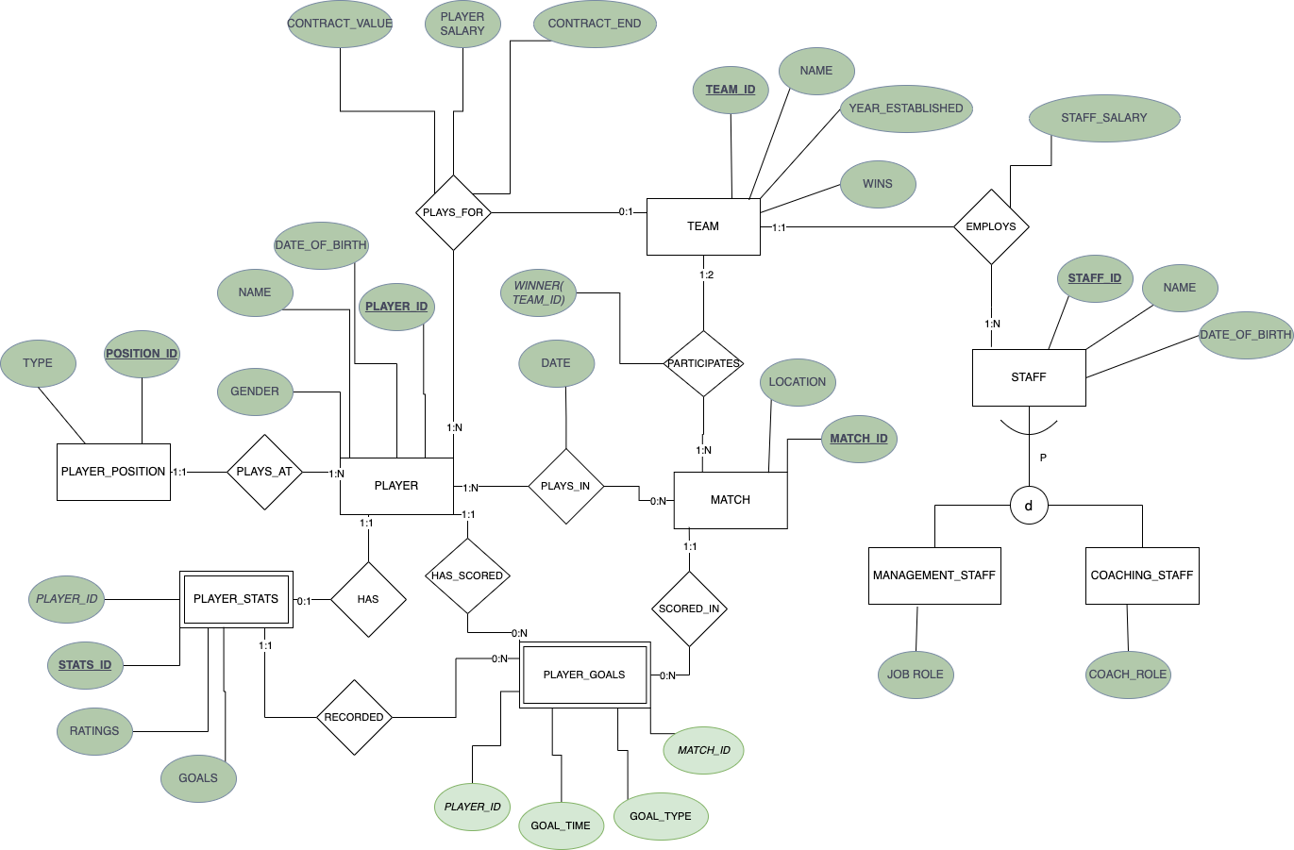
EER-Diagram
9 Entities
12 Tables
Specialization for staff entity

Slide 4
Analytical perspective
In order to spot patterns and trends, statistical analysis entails looking at statistics like as goals, assists, and other important performance metrics. This can assist coaches and analysts in finding areas of a team's performance where they can make improvements.
Examining player and team performance over time to spot trends and patterns is the goal of performance analysis. Over the course of a season or competition, this can assist coaches and analysts in tracking development and identifying areas for growth.

Slide 5
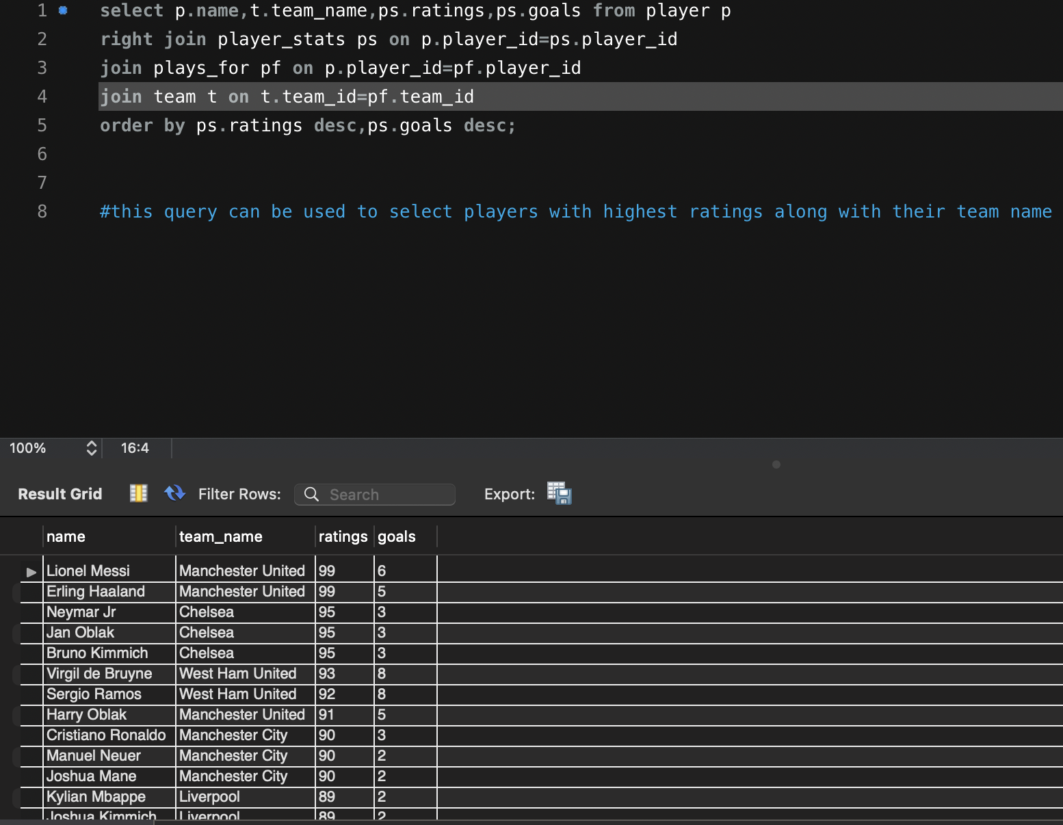
Player ratings vs goals scored

Slide 6
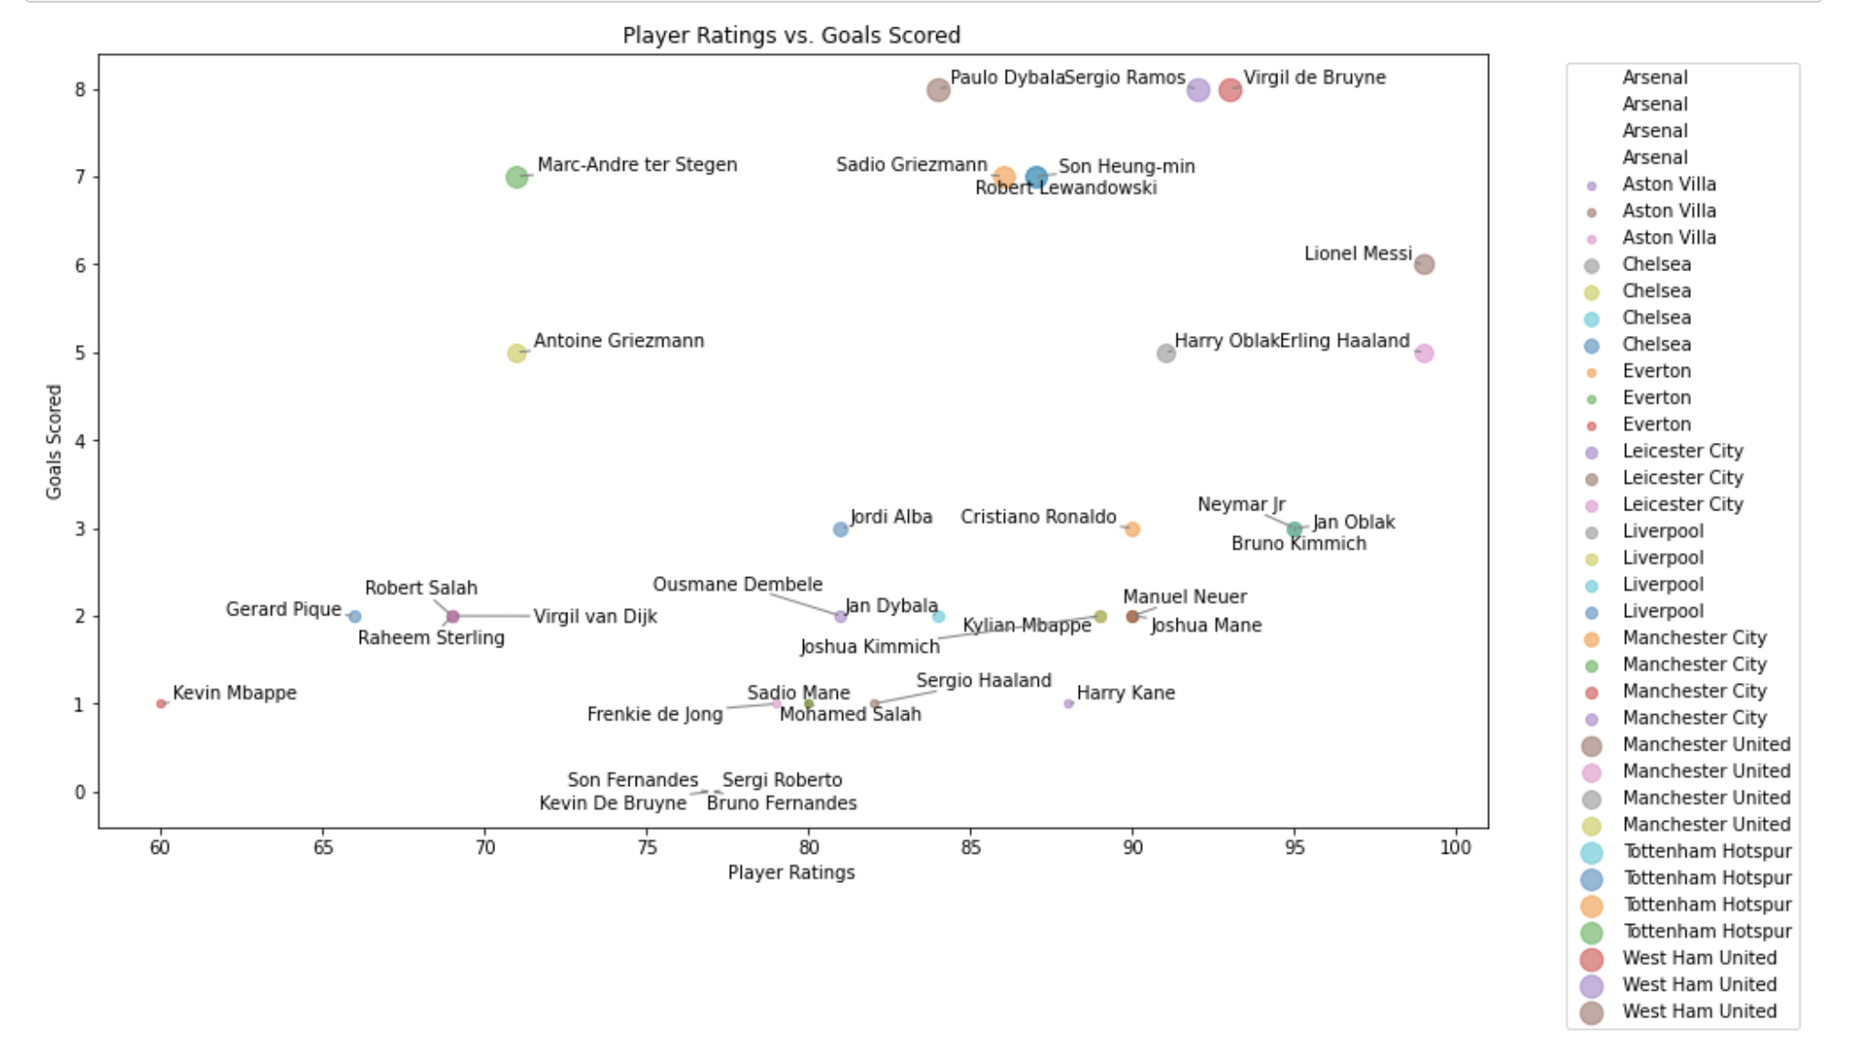

Slide 7
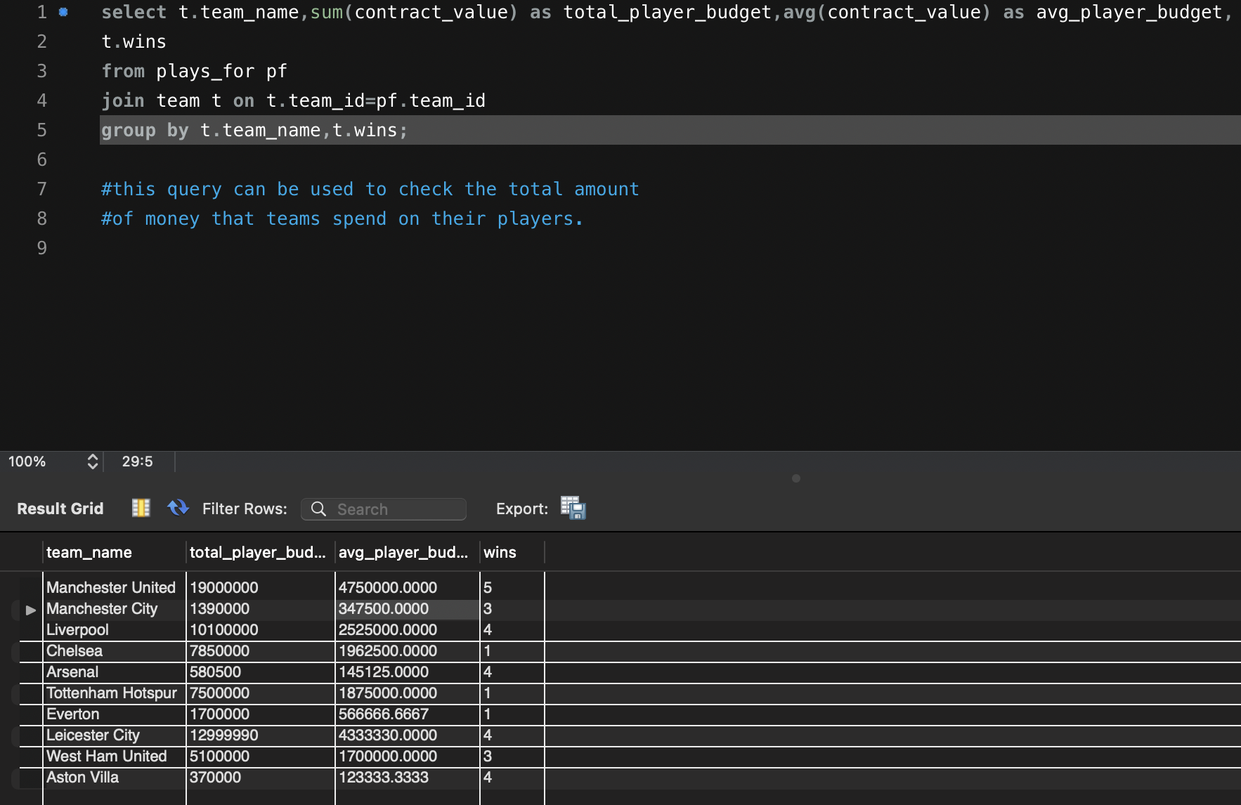
Budget spent on players and wins

Slide 8
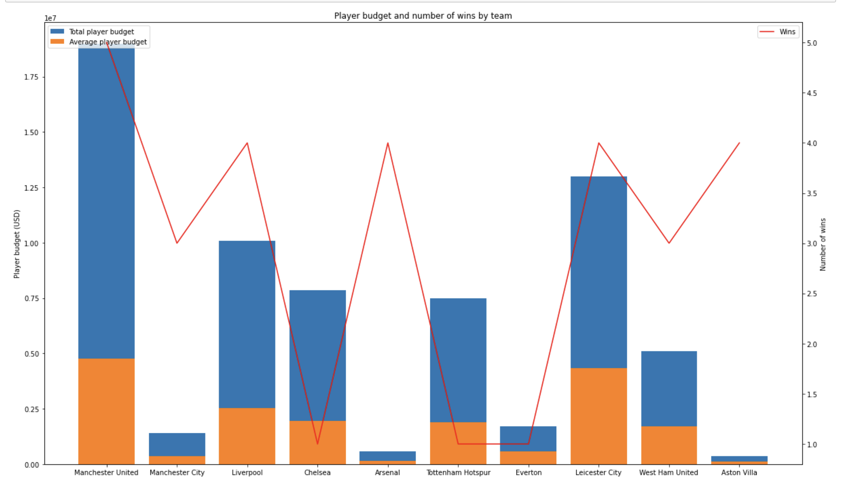

Slide 9
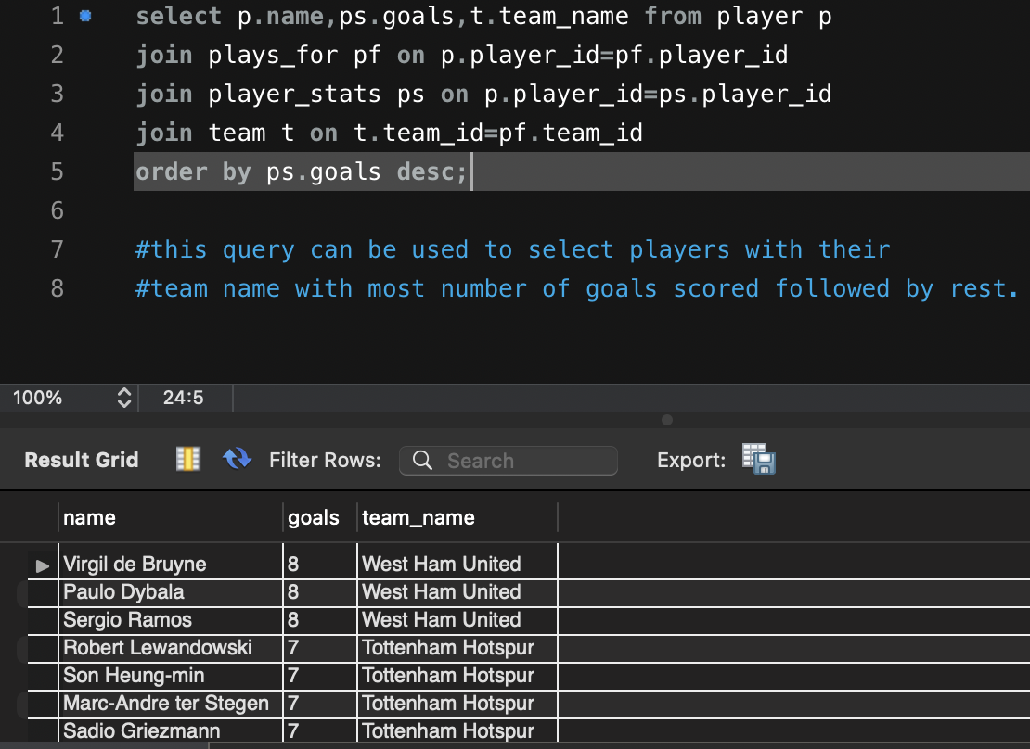
Top goal scorers

Slide 10
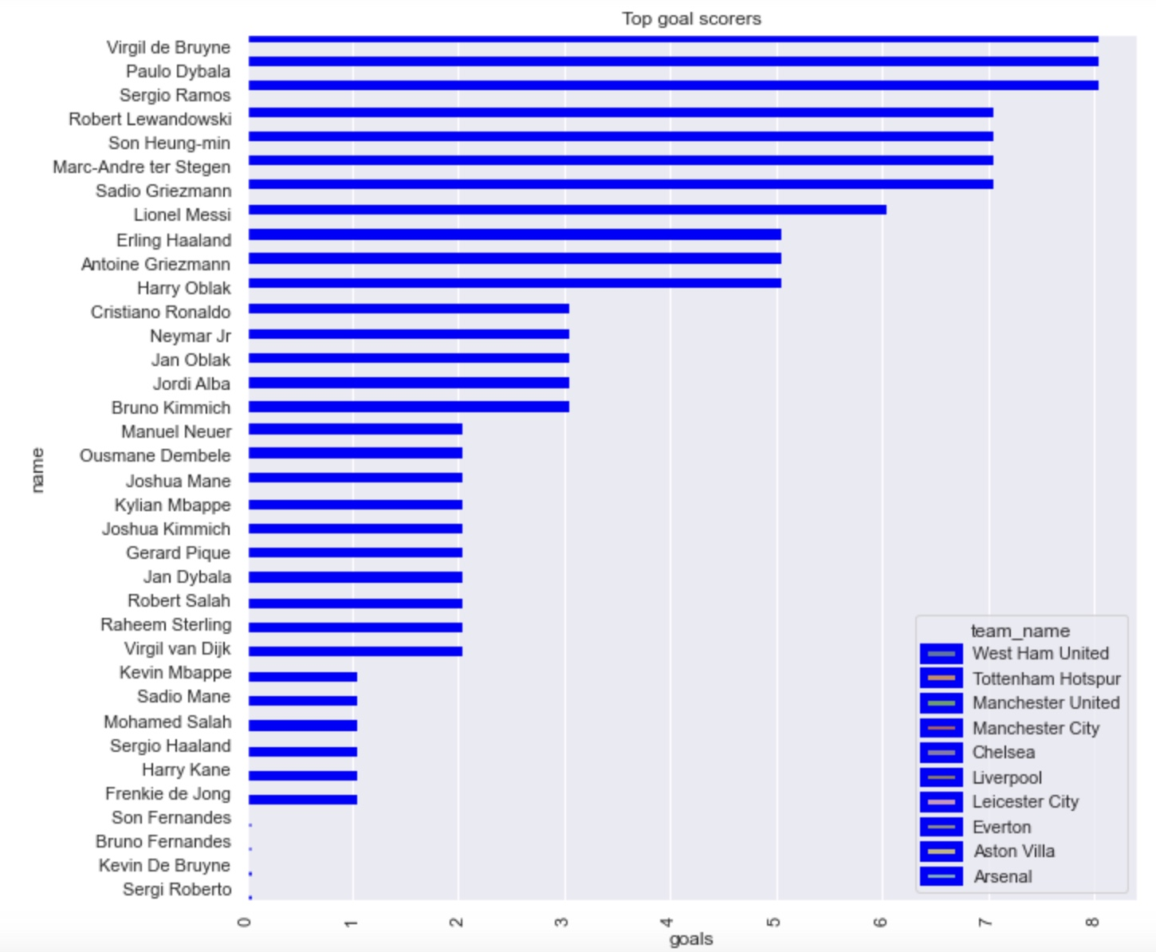

Slide 11
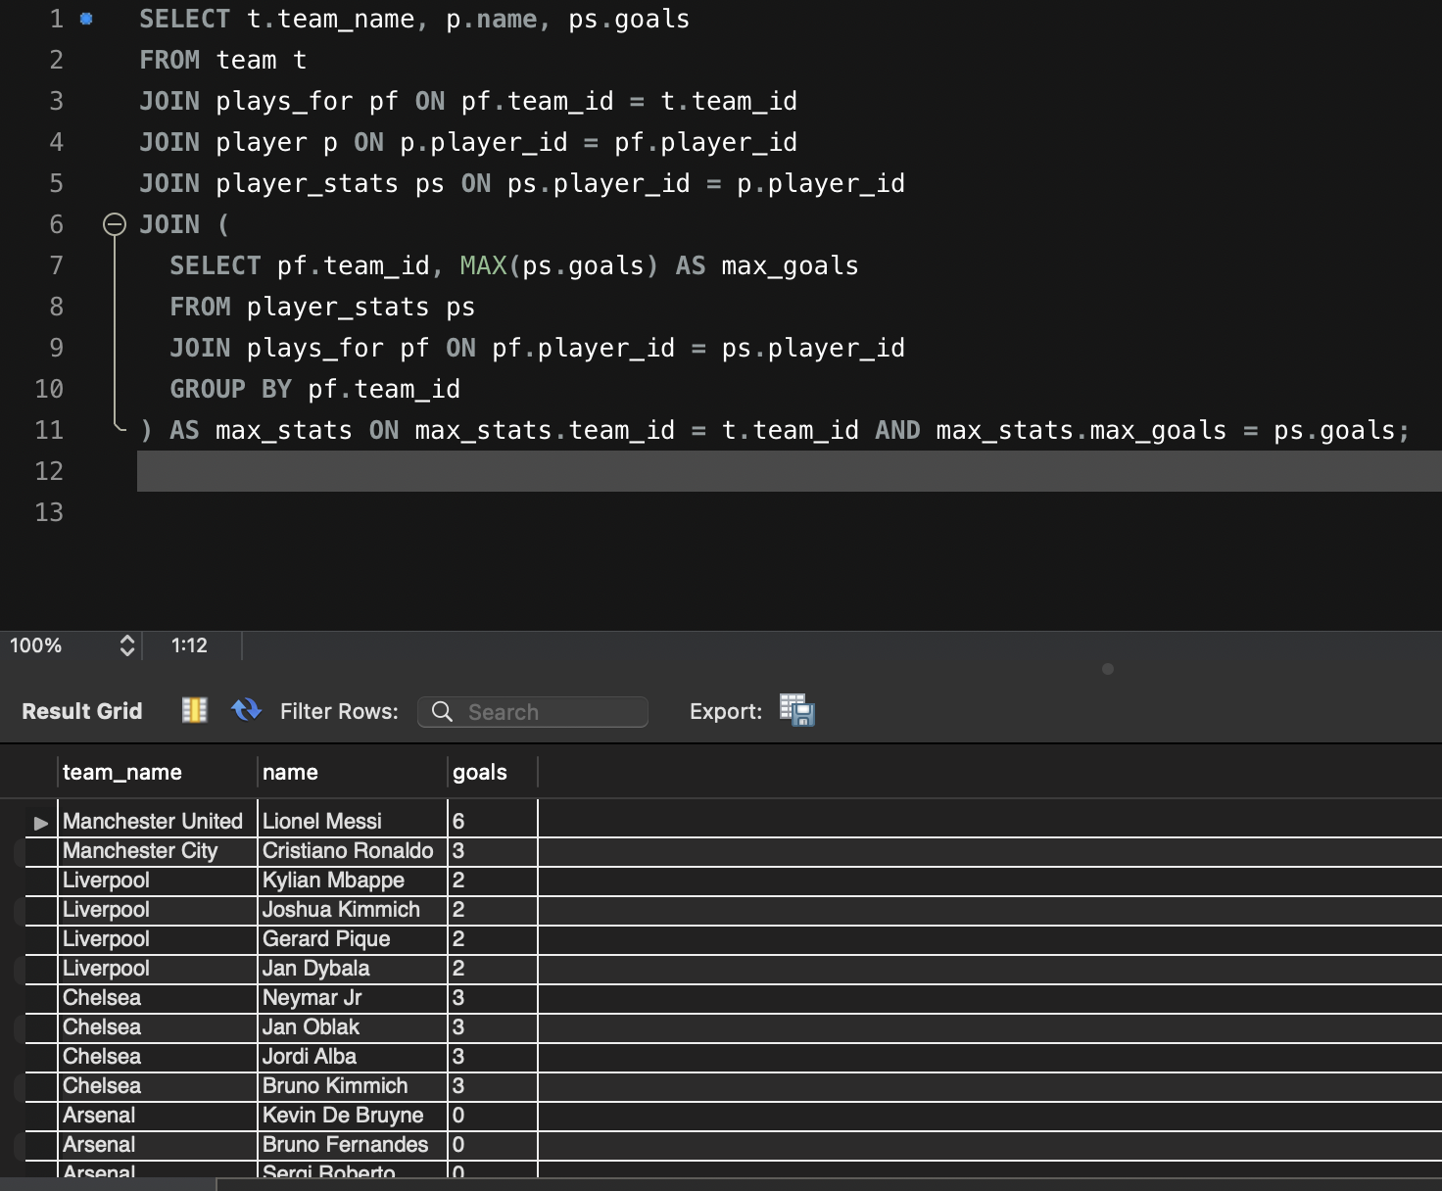
Top Goal Scorer for their team

Slide 12
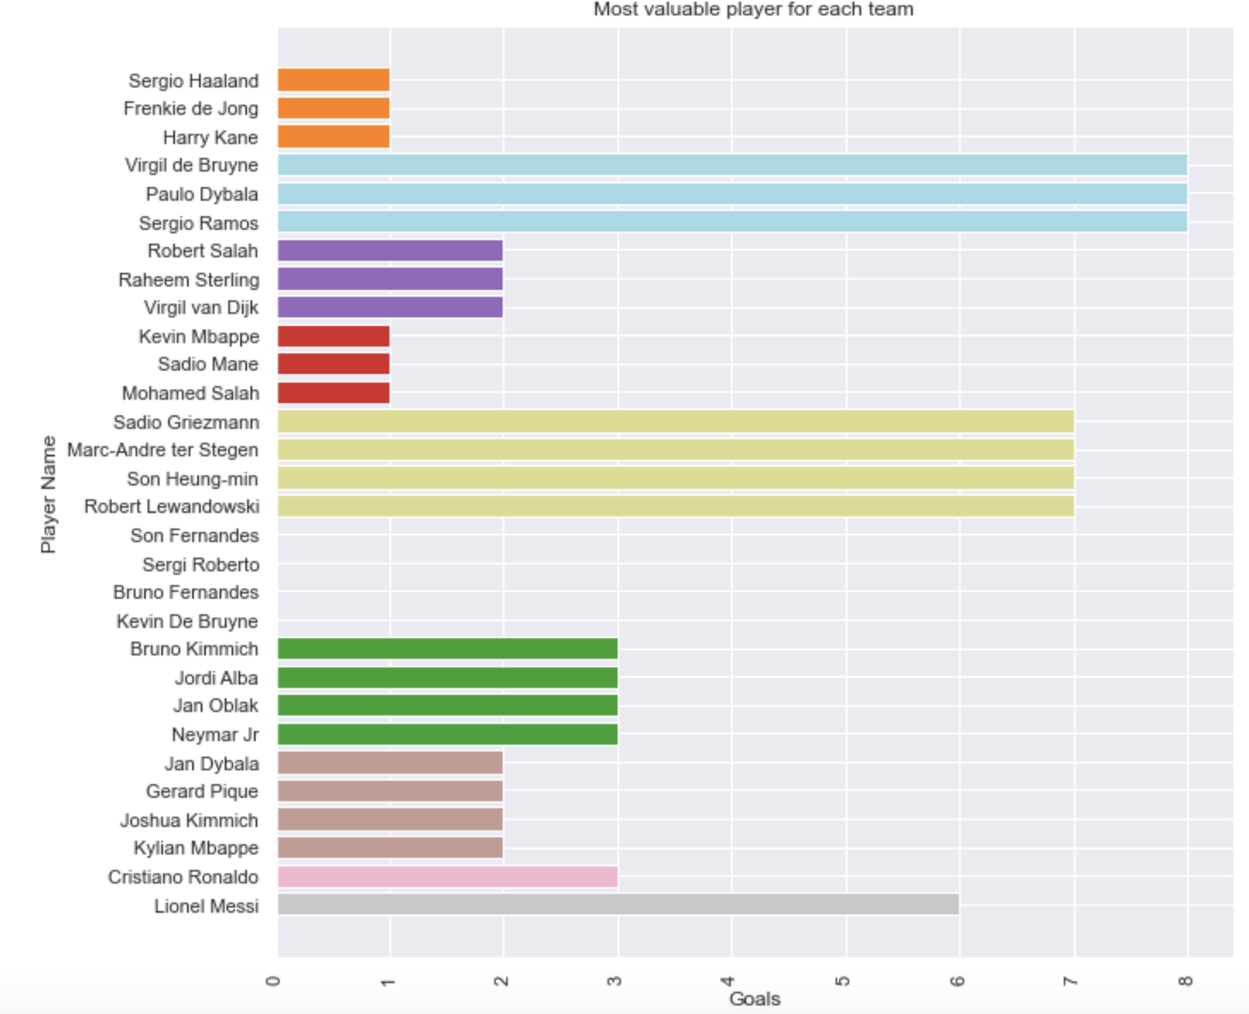

Slide 13

Thank you

